Slide 1
The Modern Resume Building Your Brand
Steve Jones
Editor, SQLServerCentral
Database Weekly
Red Gate Software
SQL Share

Slide 2
Agenda
Why Build a Brand?
Practical Tips
Social Networking
Volunteering
Leadership
Blogging
Authoring
Speaking
Resume Tips
Recruiters

Slide 3
Long Tail
Notes:
Has anyone read The Long Tail? Do you know what it is? There’s this idea of niches that have value. You are a niche for your next job, or you should be. You can strive to be at the head, or the tail. Nothing wrong with tail, for the head, ping me later. For the tail, you want to move up.
Next – Wheat/Chaff

Slide 7
Long Tail
Employer Desire
Potential Employees
Notes:
Has anyone read The Long Tail? Do you know what it is? There’s this idea of niches that have value. You are a niche for your next job, or you should be. You can strive to be at the head, or the tail. Nothing wrong with tail, for the head, ping me later. For the tail, you want to move up.
Next – Wheat/Chaff

Slide 8
Long Tail
Employer Desire
Potential Employees
Notes:
Has anyone read The Long Tail? Do you know what it is? There’s this idea of niches that have value. You are a niche for your next job, or you should be. You can strive to be at the head, or the tail. Nothing wrong with tail, for the head, ping me later. For the tail, you want to move up.
Next – Wheat/Chaff

Slide 9
Long Tail
Employer Desire
Potential Employees
Notes:
Has anyone read The Long Tail? Do you know what it is? There’s this idea of niches that have value. You are a niche for your next job, or you should be. You can strive to be at the head, or the tail. Nothing wrong with tail, for the head, ping me later. For the tail, you want to move up.
Next – Wheat/Chaff

Slide 10
Long Tail
Employer Desire
Potential Employees
Notes:
Has anyone read The Long Tail? Do you know what it is? There’s this idea of niches that have value. You are a niche for your next job, or you should be. You can strive to be at the head, or the tail. Nothing wrong with tail, for the head, ping me later. For the tail, you want to move up.
Next – Wheat/Chaff

Slide 11
Notes:
Know what this is? Wheat and chaff. When you harvest, you get everything, but then you need to separate things out and get the grain. Get what you want. You want to get separated for the position that is right for you, or that you want.
In other words – (Next umbrella)

Slide 12
Notes:
Stand out of the crowd.
Next – How to stand out

Slide 13
Standing Out
Humility is good
Except
When looking for a job
Trying to get a promotion
Trying to keep a job

Slide 14
Notes:
Be careful as you move forward (next CareerBuilder)

Slide 15
Notes:
People will look for you (next trip ups)

Slide 16
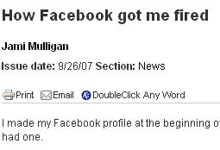
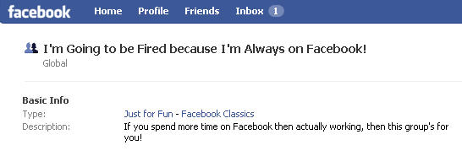
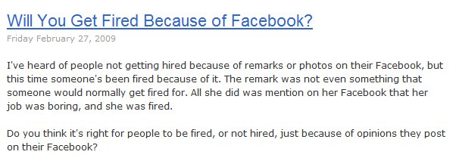
Notes:
Bad profiles
Emabaress MS, get fired (picture of Mac on loading dock)
Too much time on networking
Concept of privacy
It’s not big brother, it’s older brother.
(next Image is Everything)

Slide 19
Courts won’t generally find a privacy interest

Slide 20
Image is Everything
Not Everything, but it does matter
Notes:
Next – online profiles

Slide 21
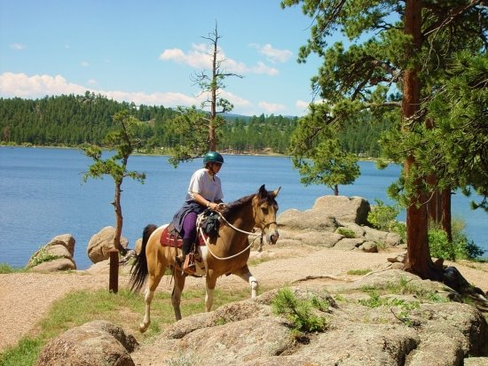
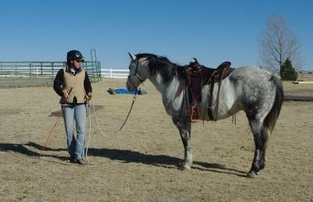

Slide 22
How to stand out?
Resume
Profiles
Networking
Volunteer
Research
Be a Leader
Blog
Publish
Speak
Can be Internal or External
Notes:
Various ways, important thing (Click) these can be external or internal to your job. External meaning out in public, internal, behind the firewall.
Next - Caution

Slide 23
Resumes
1-2 pages (resume)
CV may be longer
Keywords at the end
Make the resume human readable
Include branding links
To blog or promotional posts
Online profile
Be professional
Be relevant
Don’t be funny
Weird Things on Resumes
Notes:
Weird things
Pig wrestling champion
Cooks Exotic meats
Good things
- gold medalist
- lead in local theater

Slide 24
Cover Letters
This is the first impression
This is a pre-interview
Customize for each company
How to write one?
Google search
Practice
How not to write one?
http://www.bradmcgehee.com/2010/03/how-not-to-write-a-resume-cover-letter/

Slide 25
Online Profiles
A digital representation of who you are
The details of your career
A central repository of your work
A portfolio for clients
Tie together the various places where you have a presence.
Online Resume
Can be a summary
This can be your CV as well
Include the information that has “rolled off” your resume.
Notes:
CareerBuilder says 22% of hiring managers search for an online profile.
You want to manage your profile. Not lie, but disclose and show yourself off. (pager story)
Anyone can create one for you. Watch for your profile online. Especially if you have had issues. Don’t create one.
Washington Post or Kids test. If you wouldn’t want them to see it, don’t put it up there.
Next - Leadership

Slide 26
Online Profiles
Give “them” one
They’ll find one anyway
Be prepared to explain any you have created
And maybe some you haven’t
Be professional
You can have fun, but keep it separate
ALL your actions reflect on you, remember that.
Use “THE Test”
Notes:
CareerBuilder says 22% of hiring managers search for an online profile.
You want to manage your profile. Not lie, but disclose and show yourself off. (pager story)
Anyone can create one for you. Watch for your profile online. Especially if you have had issues. Don’t create one.
Washington Post or Kids test. If you wouldn’t want them to see it, don’t put it up there.
Next - Leadership

Slide 27
Online Profiles
Building an online profile
Your Web site
Facebook
LinkedIn
Plaxo
MySpace
Twitter
Blogger/Wordpad/Typepress/other
Include Contact Information
Avoid Identity Information
Keep this professional
Use another profile for personal information
Notes:
CareerBuilder says 22% of hiring managers search for an online profile.
You want to manage your profile. Not lie, but disclose and show yourself off. (pager story)
Anyone can create one for you. Watch for your profile online. Especially if you have had issues. Don’t create one.
Washington Post or Kids test. If you wouldn’t want them to see it, don’t put it up there.
Next - Leadership

Slide 28
Online Profiles
Google Alerts
Monitor what is being posted about you
Have this profile ready at all times
This can be the first place you point people
Update this quarterly as your career advances
Summarize all your accomplishments in one place
Notes:
CareerBuilder says 22% of hiring managers search for an online profile.
You want to manage your profile. Not lie, but disclose and show yourself off. (pager story)
Anyone can create one for you. Watch for your profile online. Especially if you have had issues. Don’t create one.
Washington Post or Kids test. If you wouldn’t want them to see it, don’t put it up there.
Next - Leadership

Slide 29
Notes:
Not a bad joke, but I wasn’t aware this was posted until someone told me. It could have been something that I would have been upset about, and while you can’t do anything about it, you can help to explain it if you are aware of it.

Slide 30
Social Networking
?
Notes:
Survey, count members of each
Next - Authors

Slide 31
Social Networking
Web 2.0 / Social Networking
No different from the real world
Chamber of commerce
User groups
BBB
In today’s world, the online world can take the place of these offline events.
You can still participate in offline events
Use online tools to help reinforce your offline efforts.
Notes:
Building an online network is a no different than networking in the real world. Chamber of Commerce or BB meetings, user groups, other business associations, all had happy hours or other ways for people to connect with each other, get to know each other professionally, and create opportunities.
This is the modern “golf course”

Slide 32
Notes:
This is the modern golf course. How many deals have puzzled you in business? How many times have you suggested that your boss chose a vendor over a game of golf, a dinner, or some other event. Business is involved with relationships between people. Social networking can help you expand those reaches.

Slide 33
Networking
Online tools give you a way to network with other professionals
Bonding
Sharing
A way to let others know about you
What you are engaged in
Your current status
A way to hear about
Opportunities
Notes:
Building an online profile is a no different than things done in the past in the real world. Chamber of Commerce or BB meetings, user groups, other business associations, all had happy hours or other ways for people to connect with each other, get to know each other professionally, and create opportunities.
This is the modern “golf course”

Slide 34
Networking
You’ve signed up, now what?
Interact with others
Ask questions
Post comments in your work, of your learning
Survey others for their thoughts
Get inspired
Notes:
When you have signed up, now interact. Just like being at any event in the real world, you need to participate.

Slide 35
Notes:
Get to know people.

Slide 36
Social Networking
Avoid identity information
Check with your family
Keep these interactions professional
Use another account for personal information (usually)
Use an email that you can monitor.
Update this on a regular basis
Use this to interact with others
Every 2-4 weeks
Get email updates on a reasonable schedule
Notes:
Be careful what you post up there. Post contact information, but be careful about identity information. Make sure your family knows what you post, and use an email that allows people to get in touch with you, and helps to keep you involved.

Slide 37
Volunteer
PASS/Local Group
Be sincere
Be sure your name is out there
Document efforts
Work
Tackle something that needs to be done
Be sure this is noted somewhere, like the intranet, company newsletter, etc.
Keep a record for your review.
Notes:
Volunteering gives back to the world. It shows that you are willing to do more than just your job. If you do career oriented volunteering, that shows that you are willing to help others in your field. You would be someone that is willing to help others, without being told to do so.

Slide 38
Volunteer
Forums
Help others by answering questions
Pay it forward
Force yourself to learn more/check yourself
Note your username on your resume
Build a Project (Codeplex)
Non-Profit Organizations
Could be technical or nontechnical
Don’t volunteer unless you want to
Notes:
Forums show that not only are you willing to help, but you have knowledge.

Slide 39
Research
Ask questions your online
Can be added to your blog
Show some back story, thought process, some effort being made
Shows you are learning and unafraid to ask for help.
Shows that you know how to find help
This can be useful in an interview
Notes:
Ask your own questions online. As you learn something, put it back out there. Give the back story, the why, the how, the what you learned, or the how it helped you.
This shows you are working on your own career and knowledge. Both to your current boss and potential future ones.

Slide 40
Leadership
Everyone needs leaders
Leader != Manager
But it helps
You can be
Project leader
Organization leader
Thought leader
This does not have to be in technology!
Document your efforts
Notes:
Leadership helps you stand out.
This is not a manager, though it can be. And that helps.
Project leader – On some task, provide coordination, direction, ideas
Organization – Can be internal or external, formal or informal.
Thought – Just express yourself. You can be someone that people follow, or maybe counsel
Next - blogging

Slide 41
Blog Survey
Who has a technical blog?
Who reads technical blogs regularly?

Slide 42
Blog Survey
Who has a technical blog?
Who reads technical blogs regularly?
10% have technical blogs
80% read blogs
Notes:
More people read, few people write. This builds communication skills, and shows off your knowledge.

Slide 43
Blogging
A chronicle
This is a your voice
Write about what you
Learn
Know
Solve
Do
Think
Notes:
This is your chance to show off what you know.

Slide 44
Blogging
Don’t overthink it.
Tackle small, discrete items
Ignore similar posts
Remember this is about YOU!
Building a publishing platform is a different type of blog. You can do this, but you do not have to.
A long term chronicle of your career.
Keep this blog professional
Relate it to your career
Notes:
Examples: backups fail, trying to explain why log restores needed.
Issues with working over the phone
disconnect with developers, manager
Going to work late, after hours
Organization of files
impact to organization, what I could minimize in the future.
Building a Report
Request comes in, how you analyze the request and get more information
Structuring this report to meet needs, decisions taken
Writing queries, simple, complex, how the query translates into the business need, planning for future changes, tuning, looking at indexes
New Report
New person? How are they different. Same person, has it gotten better
Checking for similar reports, looking for reuse
New tools/features
Next - Publishing

Slide 45
Example
http://www.sqlservercentral.com/blogs/adventuresinsql/archive/2010/11/19/want-to-make-your-sql-server-run-faster-for-free_3F00_.aspx

Slide 46
Example
http://www.sqlskills.com/BLOGS/PAUL/post/Are-your-disk-partition-offsets-RAID-stripe-sizes-and-NTFS-allocation-units-set-correctly.aspx

Slide 47
Example
http://sqlblog.com/blogs/andy_leonard/archive/2009/01/30/an-introduction-to-the-ssis-expression-language.aspx

Slide 48
A Mistake
Politics
Development

Slide 49
How to blog
Get Permission
Be smart
Don’t disclose financial information
Keep company secrets secret
Be consistent
Pipeline and schedule
Be clear
A survey of hiring managers showed they tend to look at 5-10 posts.
Notes:
Ask your boss, set rules, keep it simple
Don’t do anything that you wouldn’t want done to you
Get ahead of the curve and make this a regular occurrence. Choose a reasonable schedule. I’d say once every other week at a minimum, set reminders in Outlook.
If you have nothing interesting, write that. IF that happens too often, think about that as well. Time for a new job
Imagine you’re writing for a jr DBA or new guy in your position, explain things clearly. Don’t assume too much (may vary for internal blogging)
Big internal bloggers: Andy Grove – Intel,
Next – Blogging Ideas

Slide 50
How to blog
Don’t copy other posts
Don’t copy other posts
Don’t copy other posts
Do your own research
Link to others and give credit
Keep a record
Use Blogger/Word Press/Typepad
Use Word if you want more privacy
Live Writer is great
Notes:
Ask your boss, set rules, keep it simple
Don’t do anything that you wouldn’t want done to you
Get ahead of the curve and make this a regular occurrence. Choose a reasonable schedule. I’d say once every other week at a minimum, set reminders in Outlook.
If you have nothing interesting, write that. IF that happens too often, think about that as well. Time for a new job
Imagine you’re writing for a jr or new guy in your position, explain things clearly. Don’t assume too much (may vary for internal blogging)
Big internal bloggers: Andy Grove – Intel,
Next – Blogging Ideas

Slide 51
Authoring / Publishing
Become a teacher
Think “Essay”
Focus, focus, focus
Don’t be intimidated
More formal writing and editing required.
This is a step above blogging.
Notes:
1 - Print is still good, and it’s exciting, but it’s not necessary. Big time investment, more of a “head of the tail” not “Tail of the tail” idea.
Lulu – Vanity if you really want to)
2 - As you try to write online, think of writing an essay
Focus on one thing. Don’t try to solve all issues. Don’t get carried away with setup. Andy as example
3 - If you’ve solved it, there might be 1,000 people that have, but likely 5,000 that haven’t.
Next - Volunteer

Slide 52
Authoring / Publishing
Different choices
SQLServerCentral.com
SQLTeam.com
Simple-Talk.com
SQL-Server-Performance.com
SQL Server Magazine
.NET
Simple Talk
Visual Studio Magazine
Notes:
1 - Print is still good, and it’s exciting, but it’s not necessary. Big time investment, more of a “head of the tail” not “Tail of the tail” idea.
Lulu – Vanity if you really want to)
2 - As you try to write online, think of writing an essay
Focus on one thing. Don’t try to solve all issues. Don’t get carried away with setup. Andy as example
3 - If you’ve solved it, there might be 1,000 people that have, but likely 5,000 that haven’t.
Next - Volunteer

Slide 53
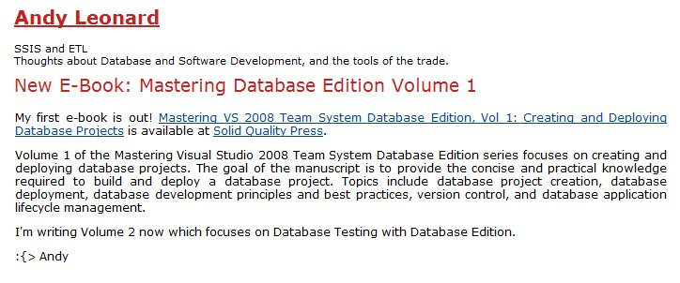
Books
Long projects
Don’t start here. Get practice with articles or lots of blogs
Lots of authors subcontract out
Social networking can help you find these
Promote it

Slide 54
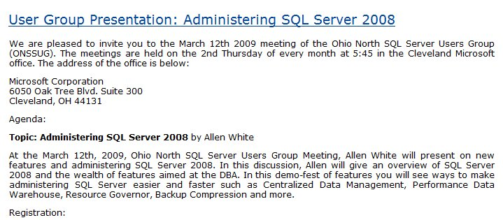
Speaking
Everyone can do this
Offline efforts
Promote it online
Market on your blog (or others)
Support with downloads
Make sure there is a permanent URL

Slide 55
Documentation
Document everything.
Never know when you’ll need something
Don’t clutter your resume
But have links available
Or have an online CV
Document mistakes
Let them know you’re not that guy:
Notes:
1 – keep track of what you do. Use Gmail/Hotmail, forward your blogs. Know what you’ve done. It helps you track your data shadow. Know what you wish you hadn’t as well.
2 – Keep your resume simple. Even in this day of electronics, go with 2 pages, no more. After 2-3 jobs, summarize to 2 lines, link to other things. A CV, complete history isn’t a bad idea.
3 – Find out what is wrong in your data shadow. Know what’s out there and have a reason, admit mistakes (know what you learned) and also be sure you know where confusion lies.
Next – End

Slide 56
Recruiters
A great source for you job hunt
Many jobs go through recruiters
Non-Exclusive
Make sure they have you branding information in a profile

Slide 57
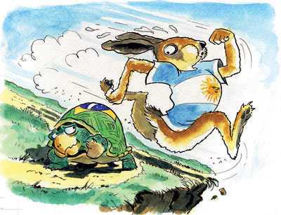
Balance
You can have a life and still do this
Work at a pace that fits your life. The key is to keep working.
Notes:
You can still have a life while you grow your brand. The key is to find some balance. Work a little less, or shift work, make this a hobby. Work at a pace you can handle. Remember this story? Who won? Steady work can build a brand.

Slide 58
Links
The Modern Resume blog – Weekly notes based on this presentation and new information.
Salary Negotiation: 32 Job Pay Tips - Focuses the job negotiation lens on the 32 salary negotiation tips for IT professionals. Includes exercises and questions to assist in preparation.
Examples of Interview Questions – Good general list of questions
The First Step is to Start – Motivational post .

Slide 59
The End
Touch your resume every quarter
If you find something that works, send me a note
Set a reminder for 6 months from today and look back
Questions?
Career Forums at www.sqlservercentral.com/forums
www.themodernresume.com
# 66

Slide 60
Thank you and Feedback
Thank you for attending The Modern Resume at SQL Saturday #66
Please make sure to fill out the session evaluation and place it in the box in the back of the room
# 66

Slide 61
Brad McGehee’s SQL Server Stumpers
"You can have an unlimited number of clustered indexes on a table."
True or False?

Slide 62
Did you know?
"SQL Compare can find differences between your source control scripts and a live database. "
Elliot Matthew Red Gate Software

Slide 63
Brad McGehee’s SQL Server Stumpers
"You can have an unlimited number of clustered indexes on a table."
False!

Slide 64
The Exceptional DBA Awards
"The awards will give an exceptional DBA some much-deserved recognition and help to increase the awareness of the importance of the DBA role among the IT community."
Brad McGehee Exceptional DBA Awards Judge
SPONSORED BY

Slide 65
Brad McGehee’s SQL Server Stumpers
"If the SQL Server Browser Service is not running, you cannot connect to a named instance by name."
True or False?

Slide 66
Did you know?
"Network resilience in SQL Backup Pro lets you create robust and resilient backups by resuming backup operations that have been interrupted by network outages."
Nigel Morse Red Gate Software

Slide 67
Brad McGehee’s SQL Server Stumpers
"If the SQL Server Browser Service is not running, you cannot connect to a named instance by name."
True!

Slide 68
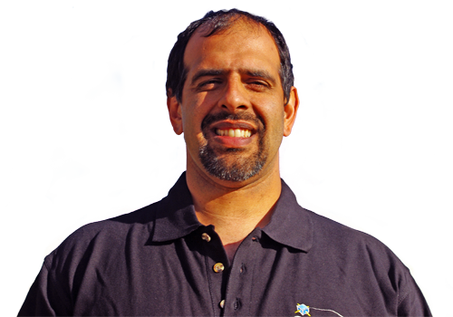
Did you know?
SQL Server Central has highly active forums, where you can get a response to a question on SQL Server and other topics in a matter of minutes.

Slide 69
Brad McGehee’s SQL Server Stumpers
"A full database backup truncates the log when the database recovery mode is set to FULL or BULK LOGGED."
True or False?

Slide 70
Did you know?
"SQL Response sends you alerts and recommendations about the health and activity of your SQL Servers, so you can work proactively to minimize problems." David Connell Red Gate Software

Slide 71
Brad McGehee’s SQL Server Stumpers
"A full database backup truncates the log when the database recovery mode is set to FULL or BULK LOGGED."
False!

Slide 72
Did you know?
Simple-Talk.com has a wealth of articles written by industry experts on SQL Server, .NET and SysAdmin, with no registration required to access each article.

Slide 73
Brad McGehee’s SQL Server Stumpers
"After updating the fragmentation of an index using ALTER INDEX REBUILD you don't need to update the statistics."
True or False?

Slide 74
Did you know?
"SQL Prompt simply sits behind the scenes and provides unobtrusive help when you press CTRL+SPACEBAR or when you type "." after a table/view/alias name. "
Simon Galbraith Red Gate Software

Slide 75
Brad McGehee’s SQL Server Stumpers
"After updating the fragmentation of an index using ALTER INDEX REBUILD you don't need to update the statistics."
True!

Slide 76
Did you know?
"SQL Compare can find differences between your source control scripts and a live database. "
Elliot Matthew Red Gate Software

Slide 77
Brad McGehee’s SQL Server Stumpers
"SQL Server automatically creates statistics on an index and it is impossible to turn that feature off."
True or False?

Slide 78
Did you know?
"The Outlook Add-ins for Exchange Server Archiver deliver a truly 100% transparent end-user experience "
Chris Bacon Red Gate Software

Slide 79
Brad McGehee’s SQL Server Stumpers
"SQL Server automatically creates statistics on an index and it is impossible to turn that feature off."
True!

Slide 80
Did you know?
"Network resilience in SQL Backup Pro lets you create robust and resilient backups by resuming backup operations that have been interrupted by network outages."
Nigel Morse Red Gate Software

Slide 81
Brad McGehee’s SQL Server Stumpers
“Certificates can be used to only encrypt other keys (symmetric or asymmetric).
True or False?

Slide 82
Did you know?
"ANTS Performance Profiler shows you line-level code timings, so you can drill down to the specific lines of code responsible for performance inefficiencies. "
Bart Read Red Gate Software

Slide 83
Brad McGehee’s SQL Server Stumpers
“Certificates can be used to encrypt data or other keys."
False!

Slide 84
Did you know?
SQL Server Central has highly active forums, where you can get a response to a question on SQL Server and other topics in a matter of minutes.

Slide 85
Brad McGehee’s SQL Server Stumpers
“In SQL Server 2008, you can mirror a database set to compatibility mode 90.”
True or False?

Slide 86
The Exceptional DBA Awards
"The awards will give an exceptional DBA some much-deserved recognition and help to increase the awareness of the importance of the DBA role among the IT community."
Brad McGehee Exceptional DBA Awards Judge
SPONSORED BY

Slide 87
Brad McGehee’s SQL Server Stumpers
“Database Mirroring does not check the compatibility mode. It will mirror a database at any level."
True!

Slide 88
Did you know?
Simple-Talk.com has a wealth of articles written by industry experts on SQL Server, .NET and SysAdmin, with no registration required to access each article.

Slide 89
Brad McGehee’s SQL Server Stumpers
“All page types can be restored with the single page restore option.”
True or False?

Slide 90
Did you know?
"SQL Compare can find differences between your source control scripts and a live database. "
Elliot Matthew Red Gate Software

Slide 91
Brad McGehee’s SQL Server Stumpers
“While data pages can be restored with the single page restore feature, the file header pages, boot page, GAM, SGAM, Diff map and ML maps cannot be restored."
False!

Slide 92
The Exceptional DBA Awards
"The awards will give an exceptional DBA some much-deserved recognition and help to increase the awareness of the importance of the DBA role among the IT community."
Brad McGehee Exceptional DBA Awards Judge
SPONSORED BY

Slide 93
Brad McGehee’s SQL Server Stumpers
“SELECT 6 | 7 returns 7.”
True or False?

Slide 94
Did you know?
"ANTS Performance Profiler shows you line-level code timings, so you can drill down to the specific lines of code responsible for performance inefficiencies. "
Bart Read Red Gate Software

Slide 95
Brad McGehee’s SQL Server Stumpers
“SELECT 6 | 7 is an inclusive OR operation, which will return 7.
6 = 0110
7 = 0111
The OR result is 0111.”
"
True!

Slide 96
The Exceptional DBA Awards
"The awards will give an exceptional DBA some much-deserved recognition and help to increase the awareness of the importance of the DBA role among the IT community."
Brad McGehee Exceptional DBA Awards Judge
SPONSORED BY

